Slide 1
Spanish-American War (1898)
Everything You Need To Know For Your APUSH Exam

Slide 2
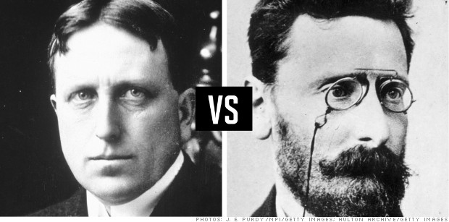
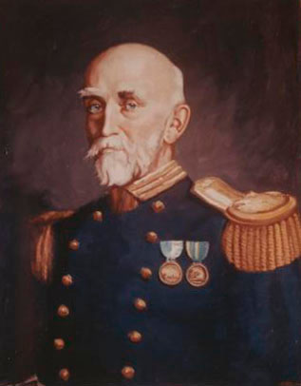
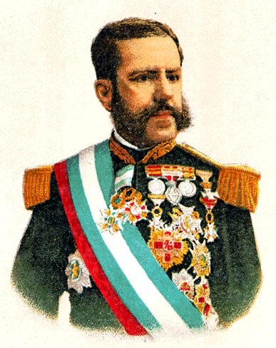
Important Topics Before the War
Alfred T. Mahan
Author of “Influence of Sea Power Upon History”
General “Butcher” Weyler
Spanish General, reports of brutality in Cuba
Yellow Journalism
Exaggeration of stories to sell newspapers
Hearst and Pulitzer

Slide 3
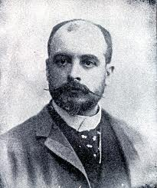
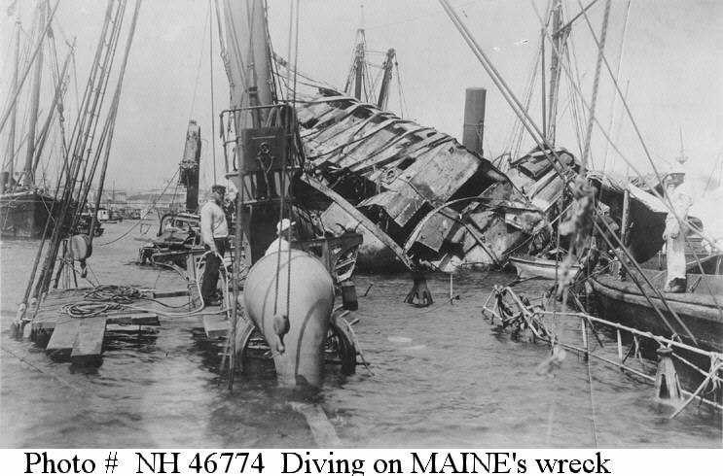
Causes of the War
USS Maine
US ship stationed in Cuba, mysteriously blew up
De Lome Letter
Written by a Spanish minister
Trash talked McKinley
Yellow Journalism
American public demanded war

Slide 4
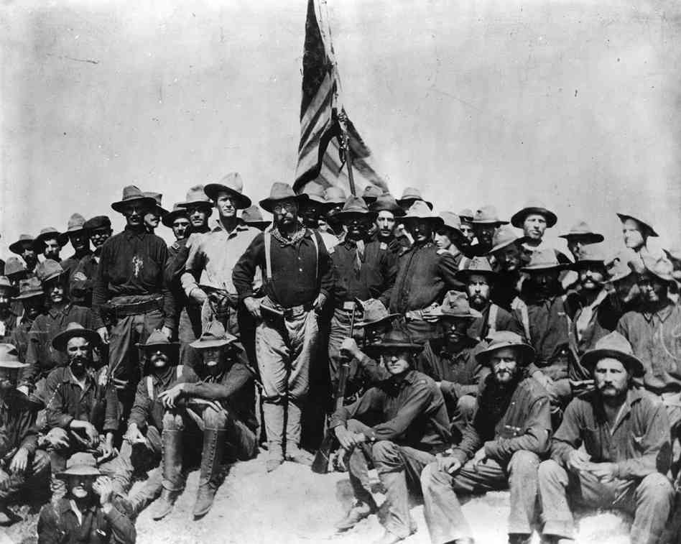
Important Info About the War
War declared on April 11, 1898
Teller Amendment:
Once US overthrew Spanish rule, Cubans would be given their freedom
Most American deaths were the result of ILLNESS, not combat
Rough Riders
US Presence in Latin America increases

Slide 5
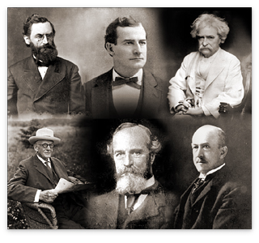
Effects of the War
Guam, Cuba, Puerto Rico, and the Philippines
Insular Cases
Constitution does not necessarily apply to new areas.
Platt Amendment (Know this!!)
Cuba can’t have treaties with other countries that compromises independence
US can intervene to restore order
Guantanamo Bay given to US
Anti-Imperialist League
Mark Twain, Presidents of Harvard and Stanford, Samuel Gompers, and Carnegie

Slide 6
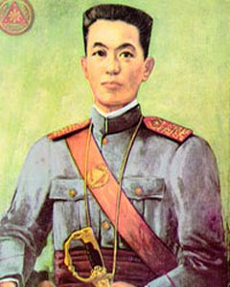
The Philippines
The Philippines thought they would receive independence
McKinley planned to “Christianize” them
Emilio Aguinaldo wanted revenge
Guerilla warfare
1946, Philippines gain independence

Slide 7
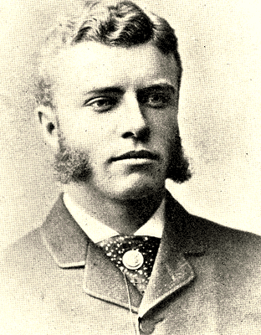
Thanks for watching!
Subscribe to APUSHReview.com
Help spread the word
Questions? Comments? Ideas for videos?

